Slide 1
Windows 10 S Case Study
Prepared by
Simon Owens
Kunal Mukherjee
Abdulaziz AlShabibi

Slide 2
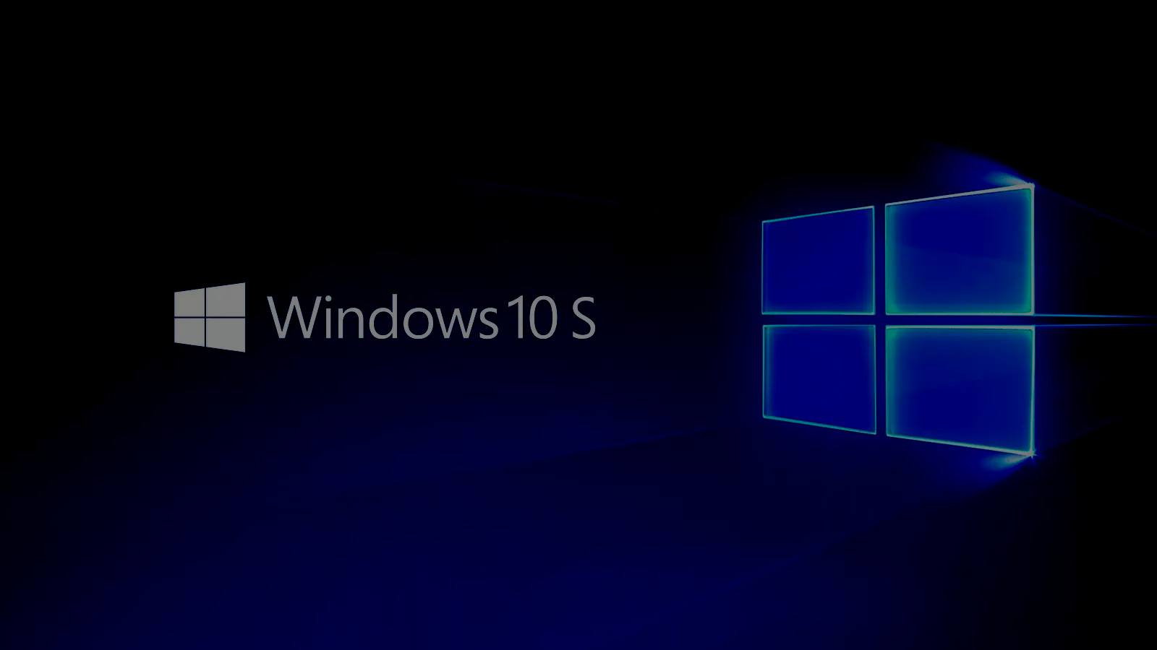
What will we cover?
History (Kunal)
Technical Overview
Processor Scheduling(Kunal)
Memory Management(Kunal)
File Management(Simon)
I/O Scheduling(Abdulaziz)
Power Management(Abdulaziz)
Security(Simon)
Application Programming Interface(Simon)
Unique Characteristics (Kunal & Abdulaziz)
Opinions on Usage (All)

Slide 3
History
Windows 10
Cheap hardware→ growth of smartphone, tablet, handheld devices
Problems for developers:
Change is ideology
A common platform for all: Windows UWP
“Windows 10 introduces the Universal Windows Platform (UWP), which provides a common app platform on every device that runs Windows 10.”

Slide 4
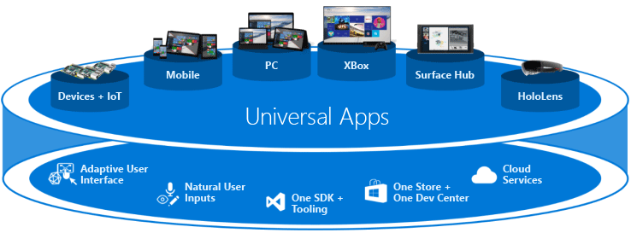
History: UWP

Slide 5
Processor Scheduling
Dispatcher- Handles the process scheduling, preemptive priority queue
32 level priority scheme to determine the order of thread execution
Special remarks- memory manager has priority 0, so that memory operations does not wait
Windows 10 let the user interfere and change the priority

Slide 6
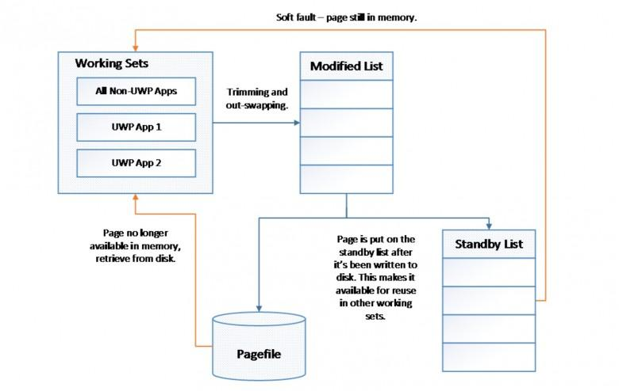
Memory Management
“All or nothing approach” -> working set (OS using the smallest amount of memory possible)
Working Set: A working set in general is the amount of memory that a process requires at a given time . The working set of a process is the set of pages in the virtual address space of the process that are currently resident in physical memory (RAM)
Adding two new list:
modified list(compressed)
Available to use for
other processes
standby list (Cache)
Transition pages
Soft fault

Slide 7
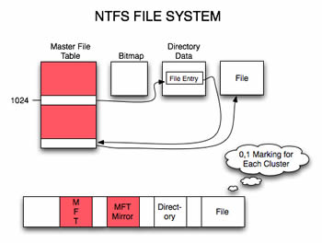
File Management
General
Name
File type
Opens with
Security
Groups or users
Permissions: modify, execute, read, write
Location
Location, size, size on disk
Time
Created, modified, accessed

Slide 8
I/O Scheduling
Only one I/O request can be served at a time
Packet Driven
I/O Request Packet(IRP)
IRP: Data structure of the I/O request
Drivers
Network
Cache
Filesystem

Slide 9
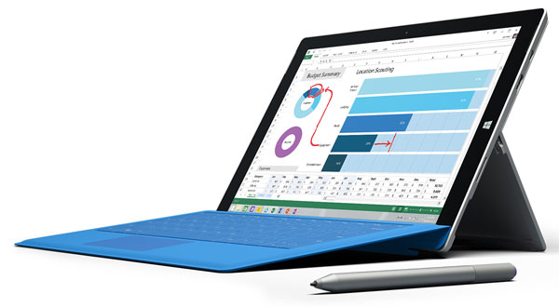
Power Management
Sleeping mode vs Hibernation mode
Default power saving options
Most devices use Qualcomm Snapdragon
Uses Edge browser which has low power consumption
Less than Chrome, Firefox, and Opera

Slide 10

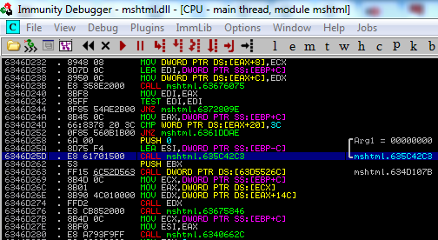
Security
Execution Protection
Scripts and Programs
Memory Redirection Protection
DEP
SOHOP
ASLR
Hardware and external Protection
Secure boot
Hard Drive Encryption

Slide 11
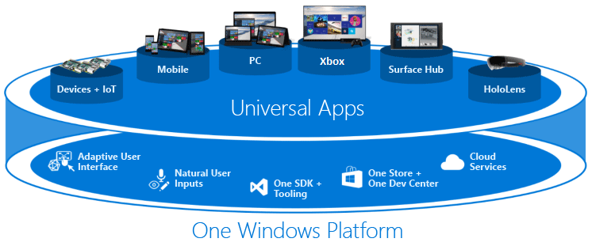
Application Programming Interface (API)
Universal Compatibility
Development Libraries
Runtimes
Development Environments

Slide 12
Unique Characteristics
UWP
Working Set

Slide 13
Opinions on Usage
Simon Owens
Most Users: Great system, better for most all users
Myself: I would use it on a tablet but prefer Ubuntu over this
Kunal Mukherjee
Myself: I would use windows for development of Games or user utilities App but, would prefer Linux system(Ubuntu or Fedora) as it gives more user freedom
Abdulaziz AlShabibi
Myself: I would not use Windows 10 S as a mobile OS because there are better alternatives such as iOS and Android. As a desktop OS, I would prefer Windows 10.

Slide 14

Questions?

